Slide 1
Feature based shape retrieval
By Pieter Michels

Slide 2
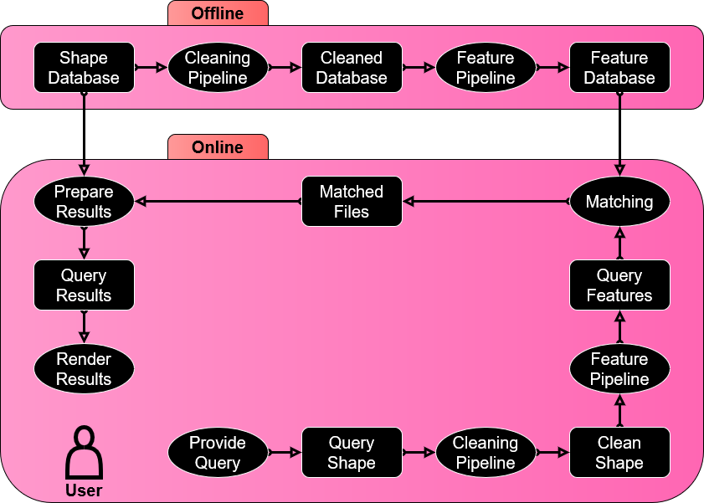
Design
Readers
Rendering engine
Pipelines

Slide 3
WhY I used Java*
Pros
Personal preference
Experience
Performance
Cons
Missing some important libraries...
*mostly

Slide 4
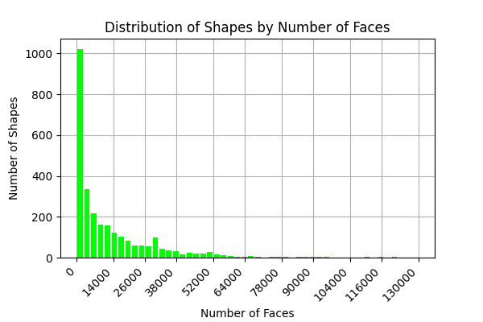
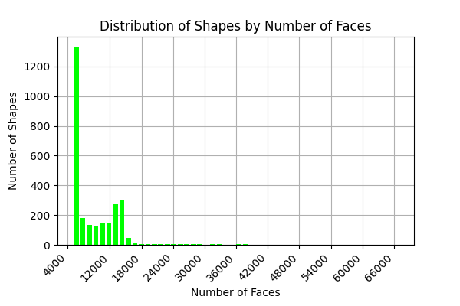
Remeshing
Before
After

Slide 5
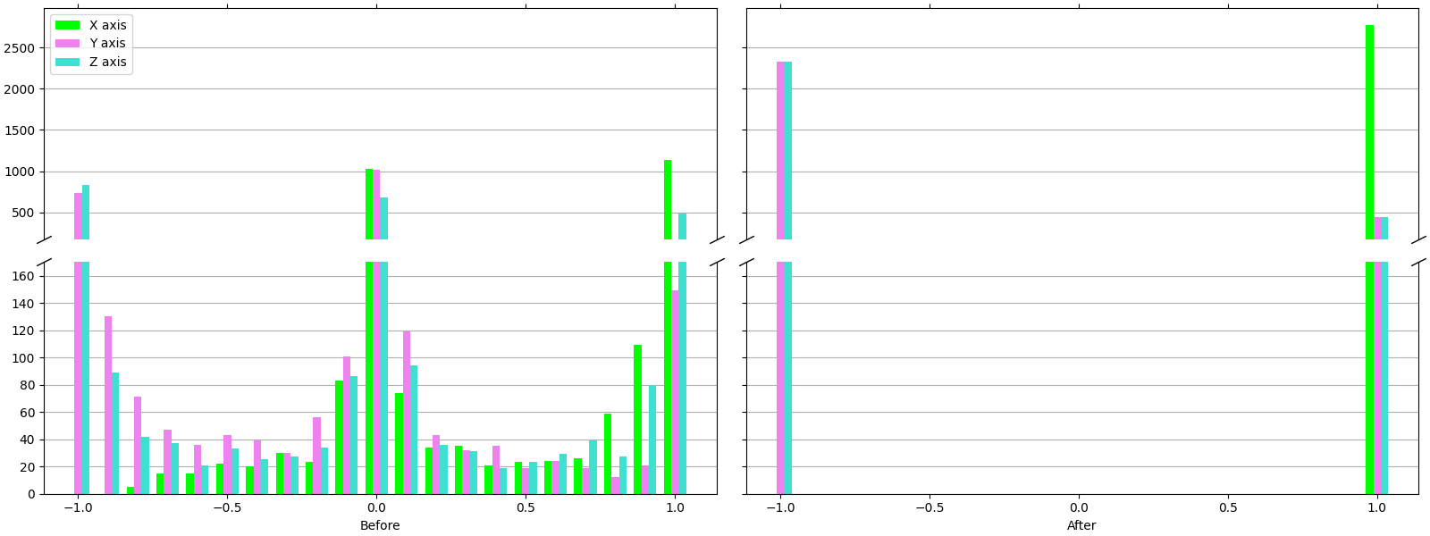
Normalization

Slide 6
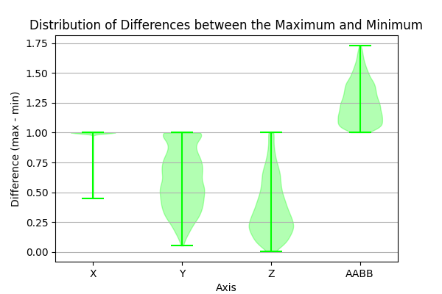
Normalization

Slide 7
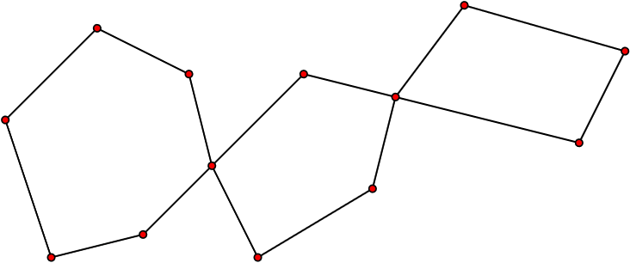
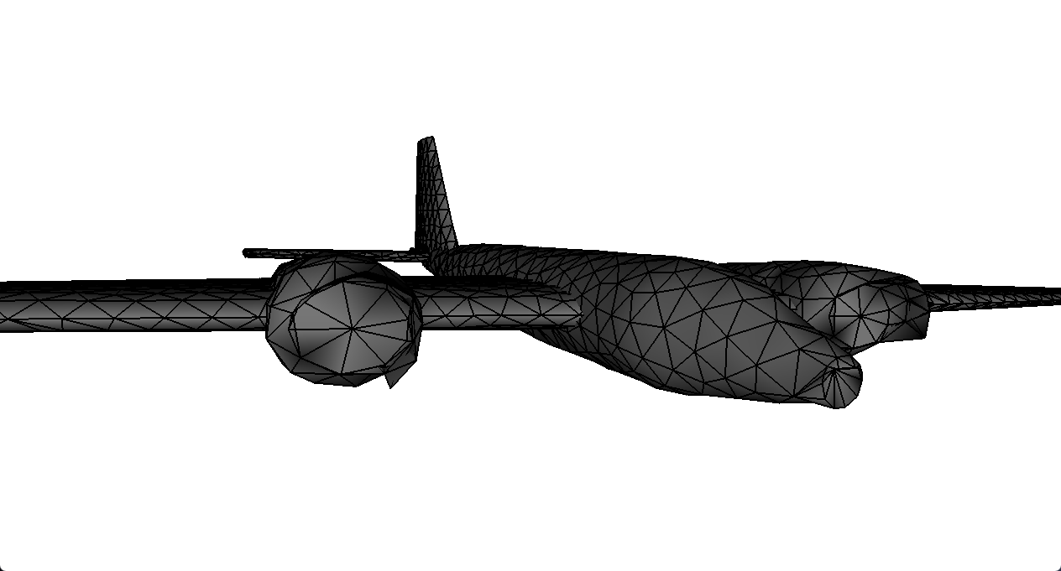
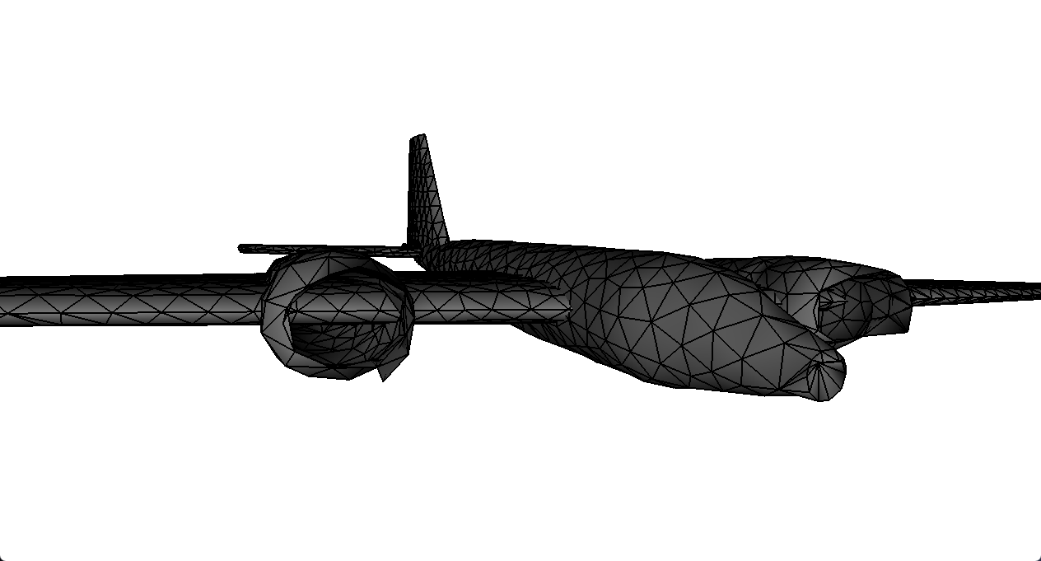
Hole Stitching
Heuristic
Connected holes
Graph problem

Slide 8




Lightfield descriptors
Had some extra time
Unhappy with preliminary results

Slide 9
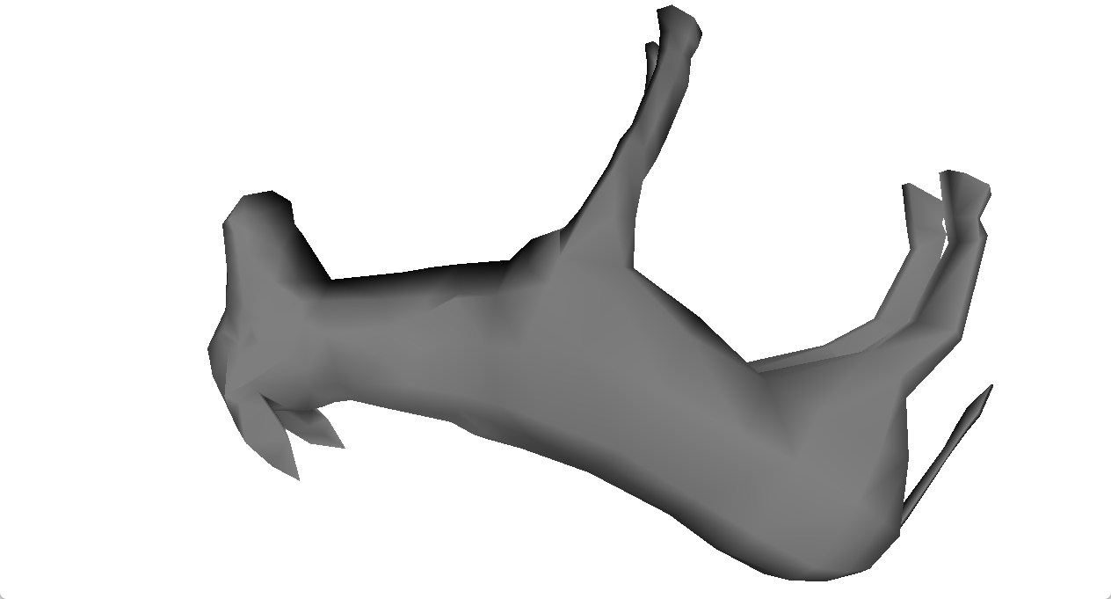
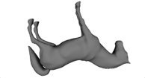
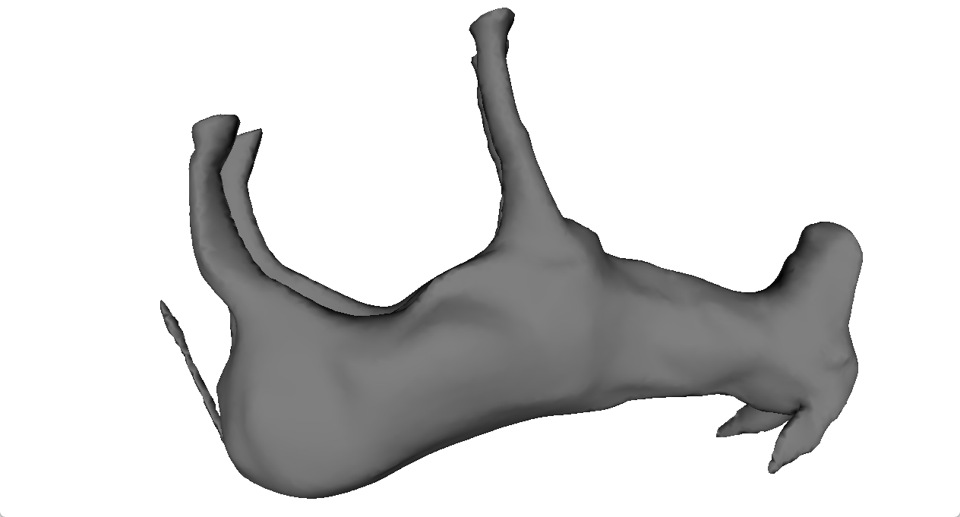
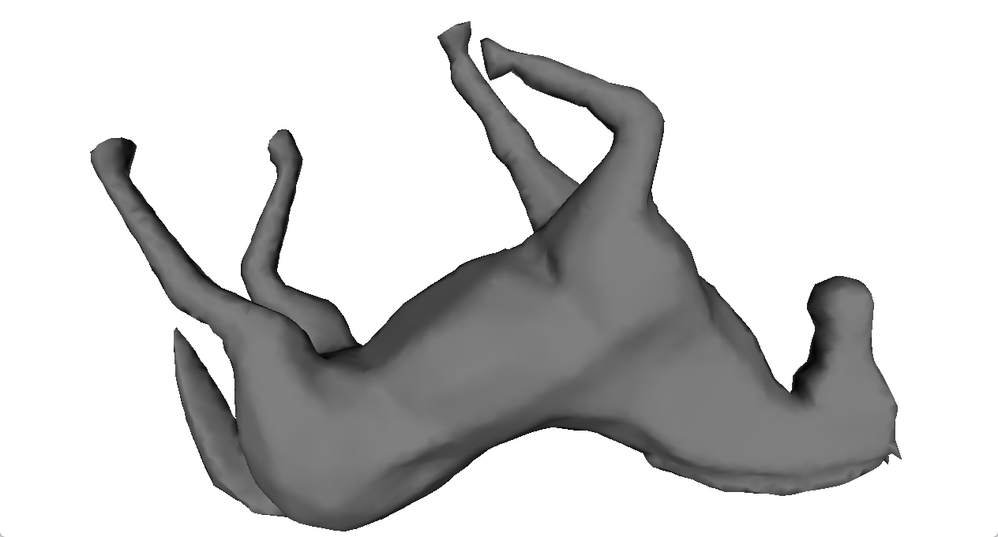
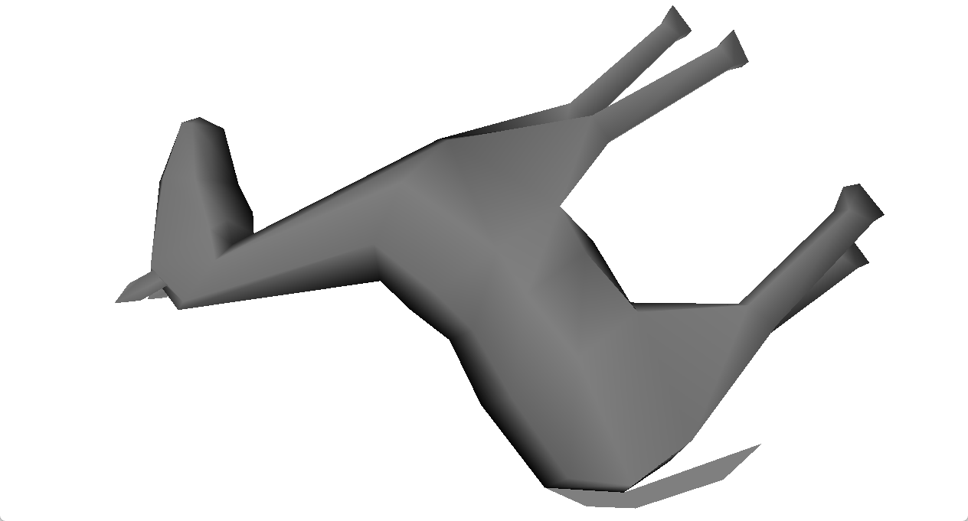
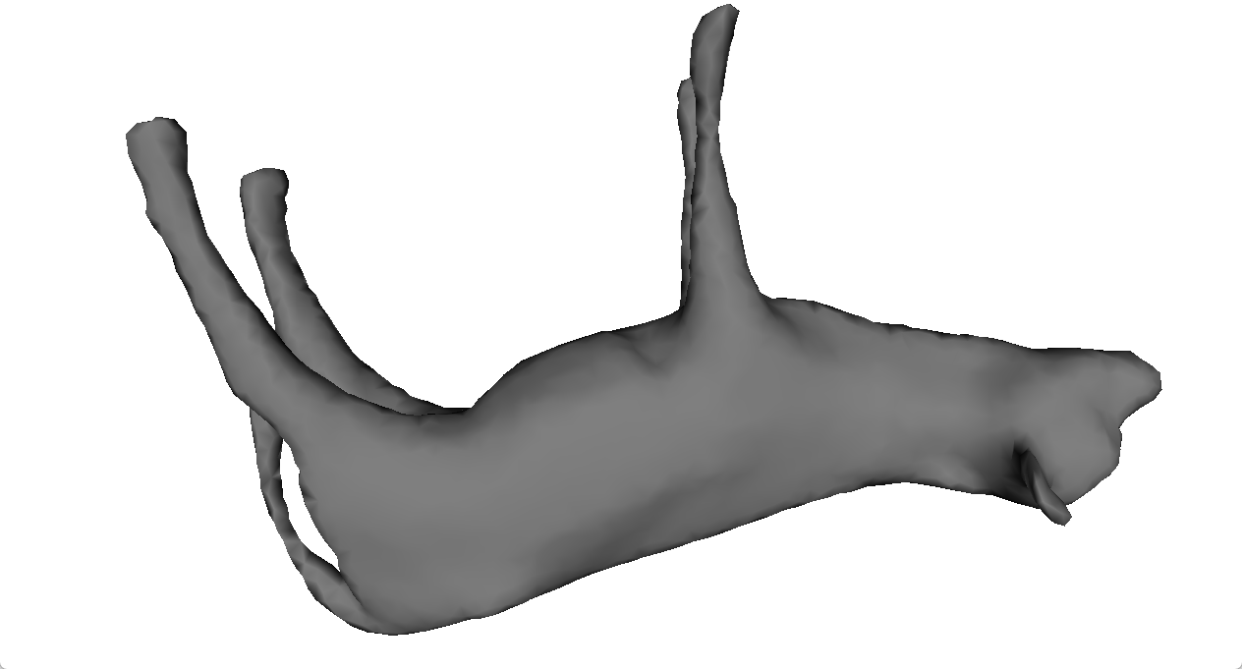
Query Results

Slide 10
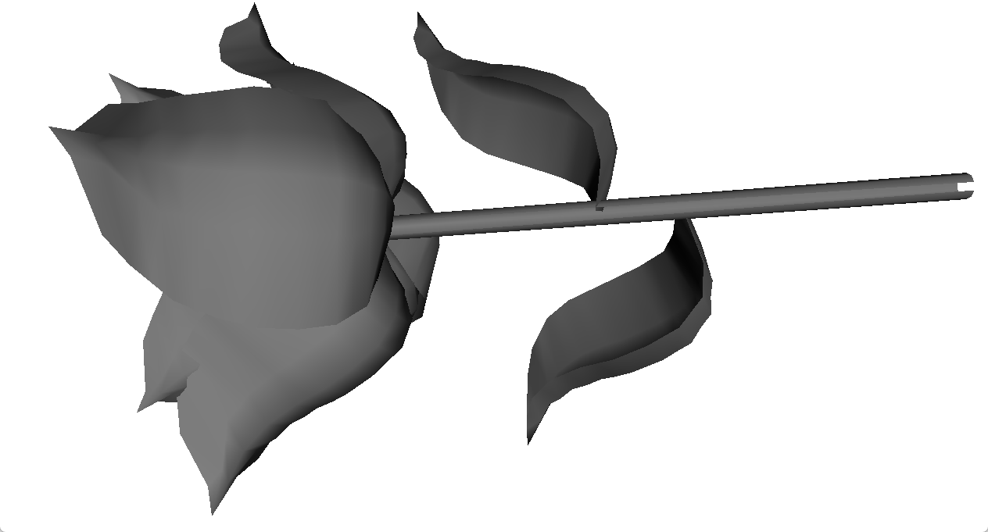
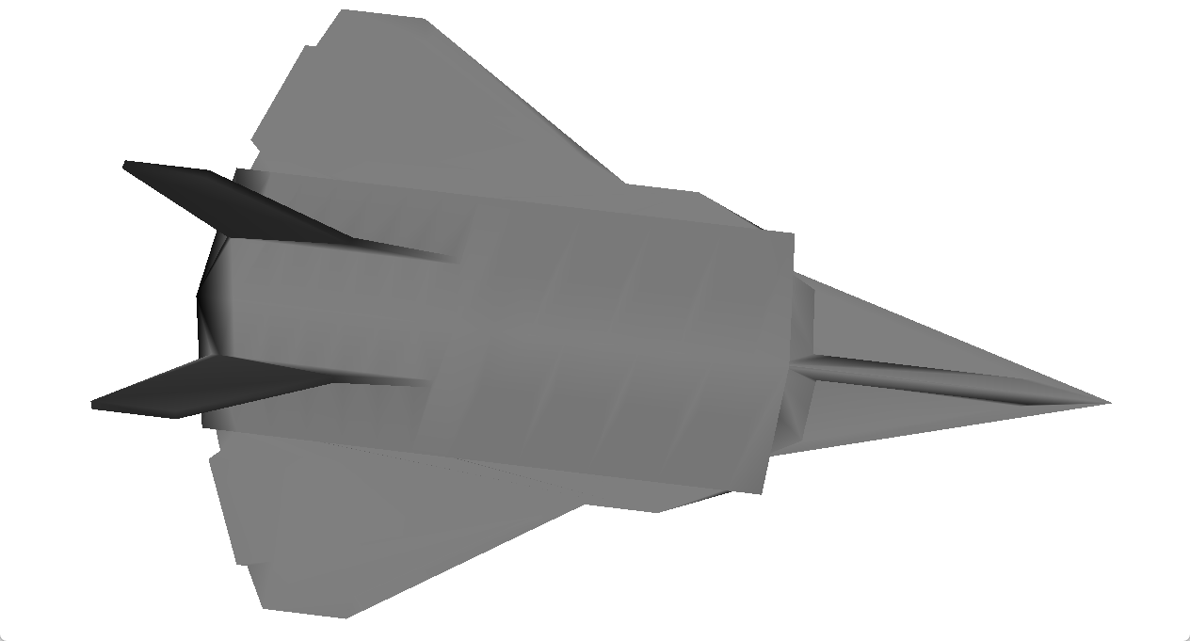
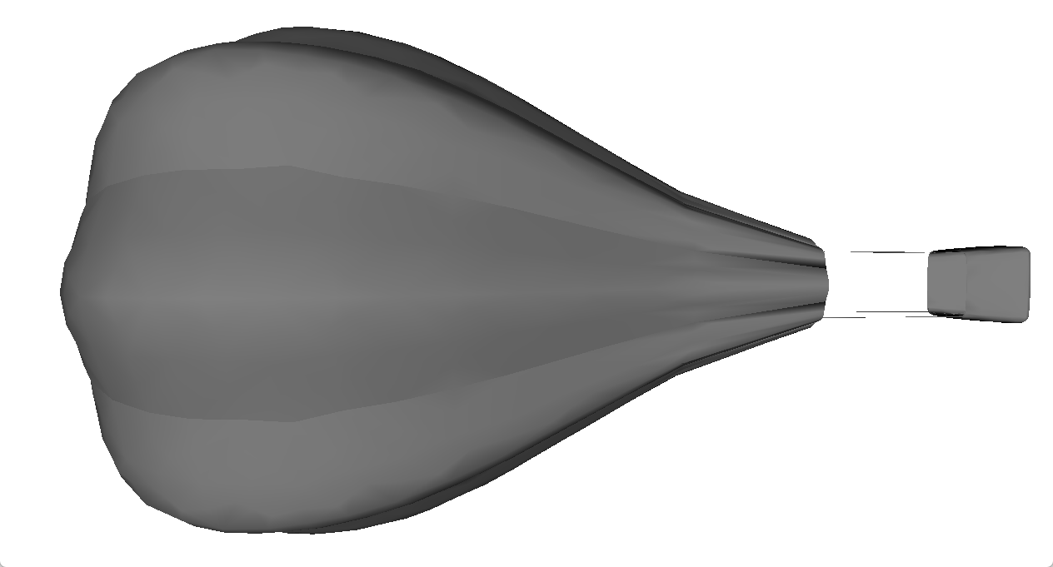
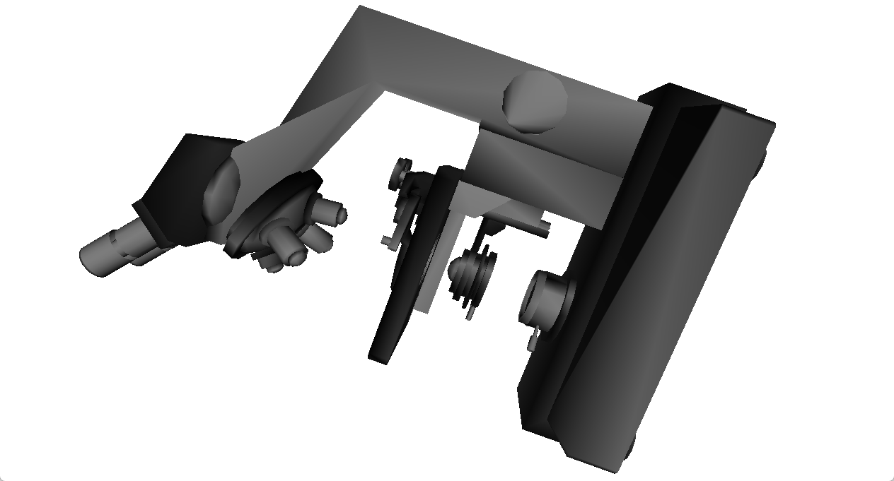
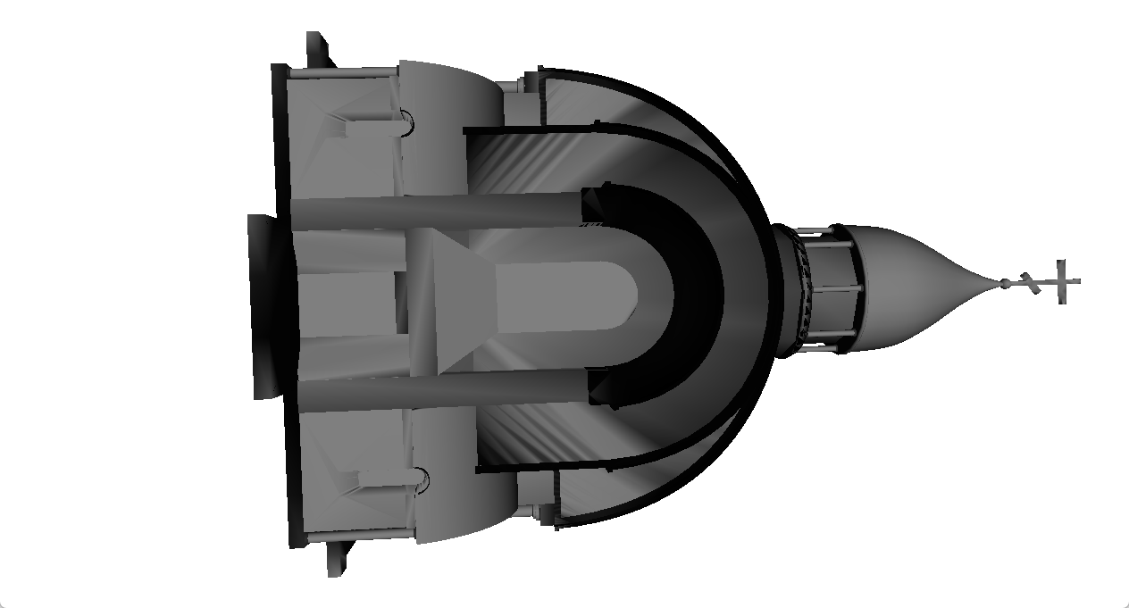
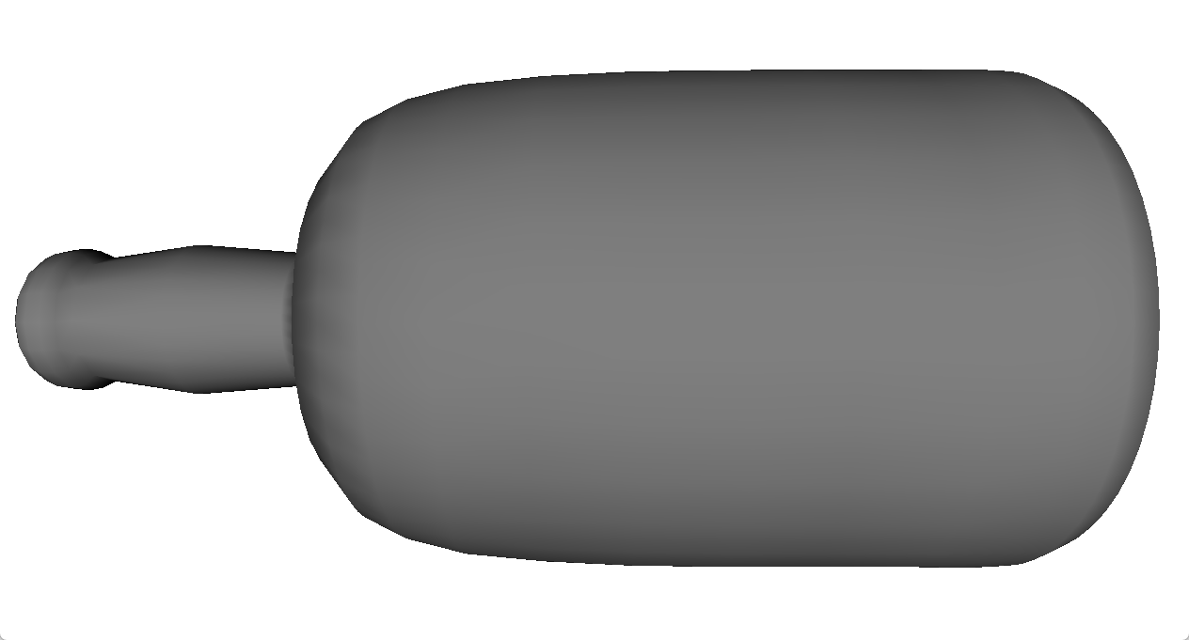
Query Results

Slide 11
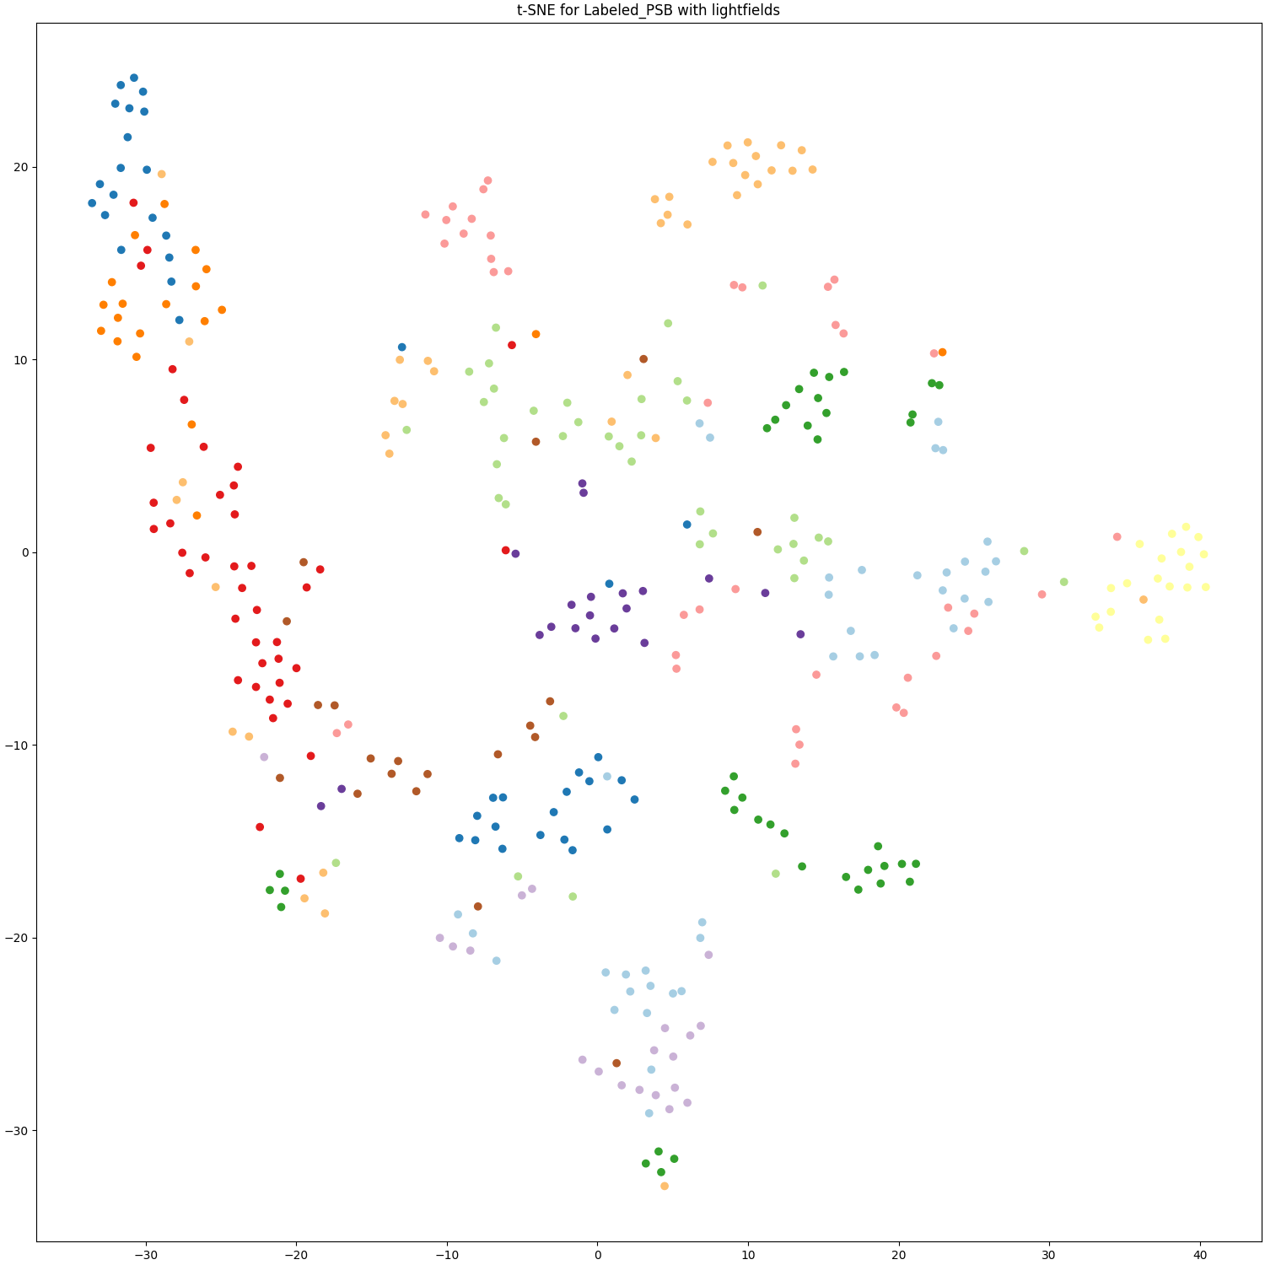
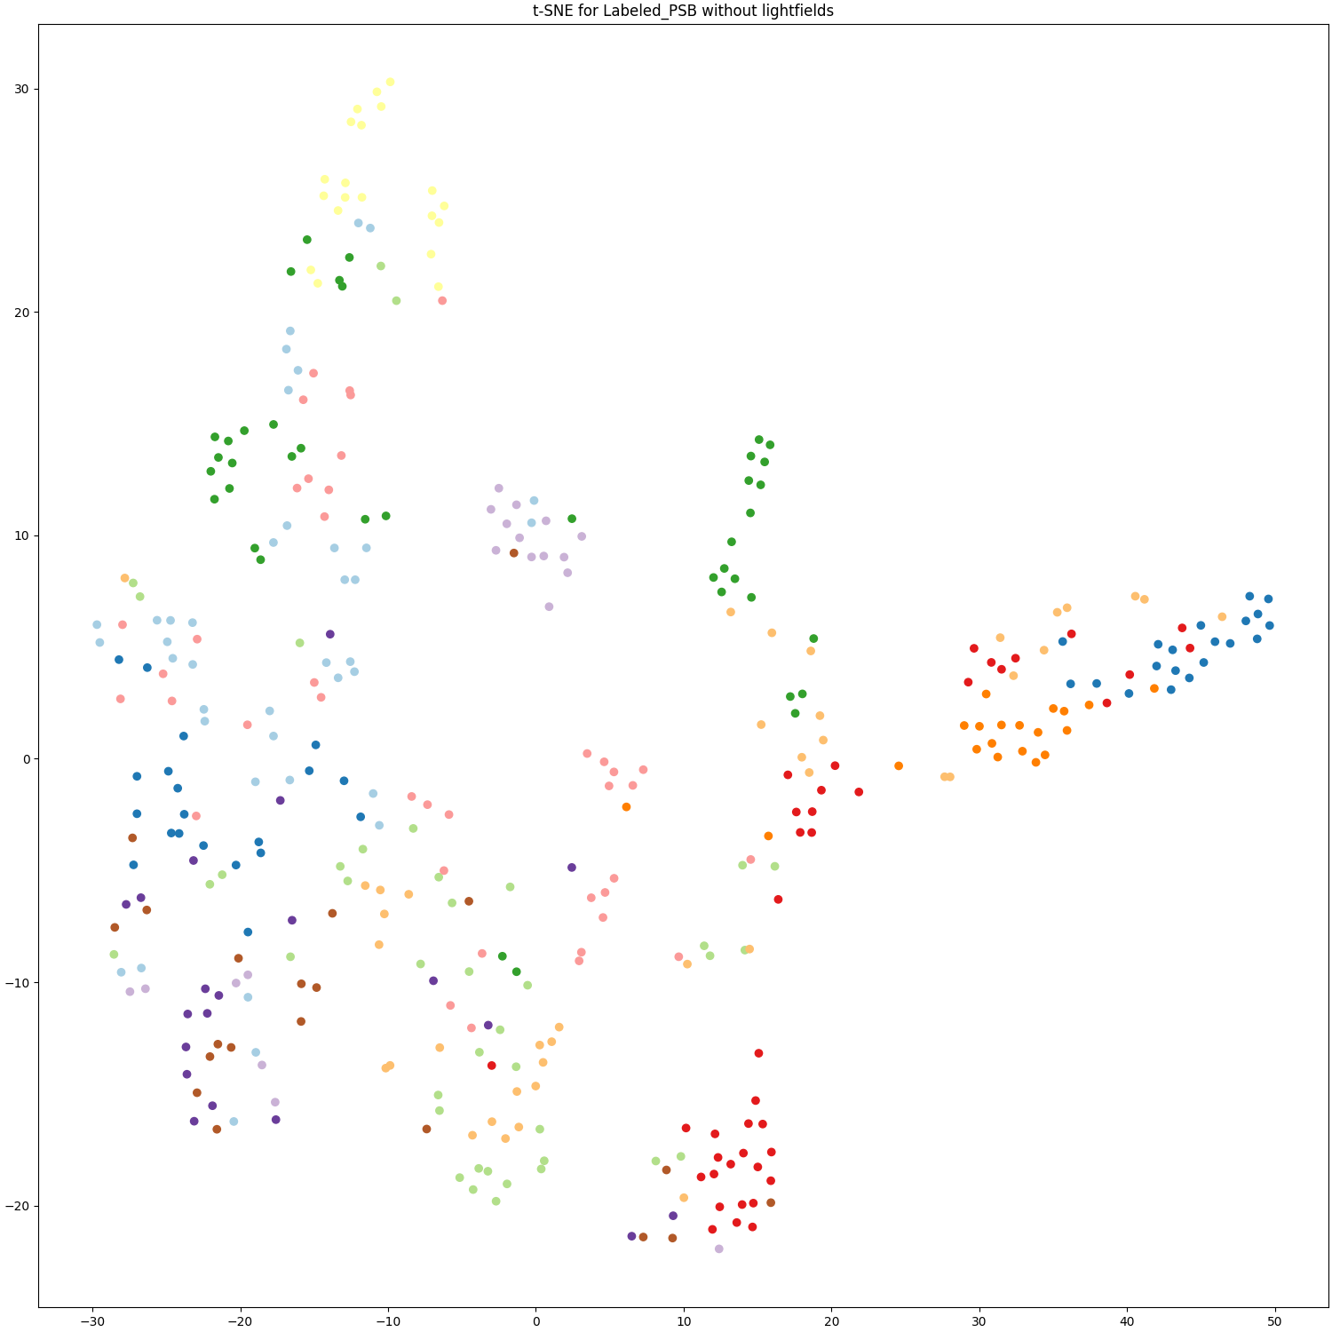
Dimensionality reduction
With Lightfields
Without Lightfields

Slide 12
Evaluation
With Lightfields
Without Lightfields
Function | K^{th} Tier | Specificity | Sensitivity
Euclidean | 50.608 | 0.986 | 0.270
Cosine | 51.194 | 0.986 | 0.265
EMD | 53.387 | 0.986 | 0.269
Function | K^{th} Tier | Specificity | Sensitivity
Euclidean | 56.513 | 0.985 | 0.222
Cosine | 54.178 | 0.985 | 0.207
EMD | 56.474 | 0.985 | 0.199

Slide 13
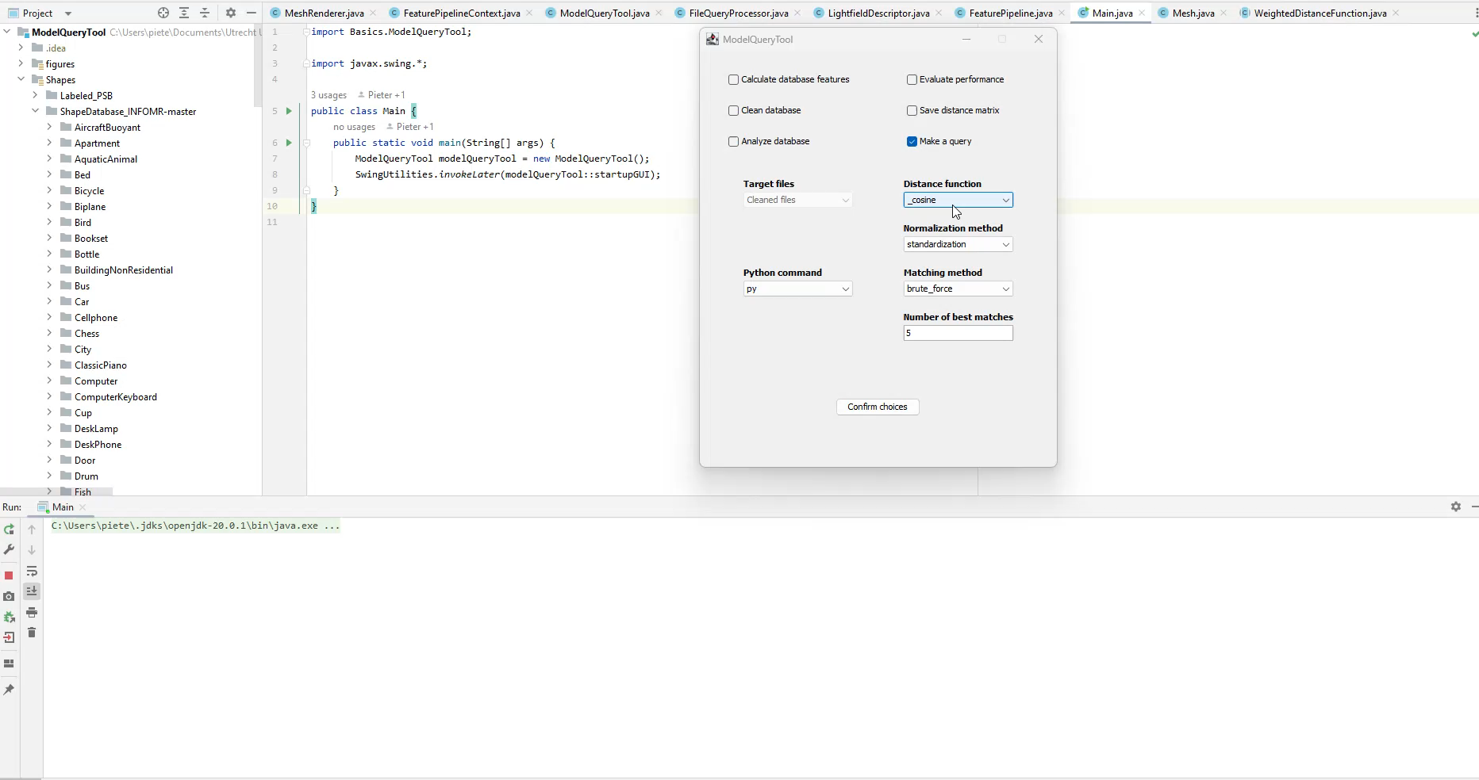
Demo

